Slide 1
AI with Bot Framework and Azure Cognitive Services
Hinault Romaric Donfack
MVP Visual Studio and Development tools

Slide 2
Agenda
Introduction to AI
Introduction to Bot Framework
Build conversationnal agent with FormFlow and Visual Studio
Deploy your Bot on Microsoft Azure
Introduction to Azure Cognitive Services
Make your Bot smart with QnA Maker
Make your Bot smart with Text Analytics API
Make your Bot smart with Luis
QnA / Conclusion

Slide 3
Introduction

Slide 4
What is artificial intelligence?

Slide 5

Artificial Intelligence
“Intelligence exhibited by machines […] mimicking functions associated with human minds” - Wikipedia
Reasoning
Understanding
Interacting
Learn and form conclusions with imperfect data
Interpret meaning of data including text, voice, images
Interact with people in natural ways

Slide 6

Why now?
Sphinx voice recognition
1992
Powerful algorithms
Grant calculator
1877
Shakey reasoning robot
1969
Compute power
VaMP self-driving car
1994
Big Data
AT&T Voder
1939
GUI
1981
Mechanical
Electronics
Computers
Cloud + AI

Slide 7
2. What can it do for me?

Slide 8

AI for your business
$1.2T
estimated additional revenue/shifting revenue driven by AI in three years
Reasoning
Understanding
Interacting
Leverage your unique data and augment your business in new, unimaginable ways
Interpret business and customer data in real time and scale including text, docs, images, video, voice
Remove technology barriers with customers and multiply employee capabilities
Source: IDC

Slide 9
Digital Transformation + AI
Engage your customers
Transform your products
Artificial Intelligence
Enable your employees
Optimize your operations
https://www.youtube.com/watch?v=M8SIs1GfSz0

Slide 10
3. What does Microsoft offer?

Slide 11
AI Platform
Comprehensive data
Business solutions

Slide 12
Innovate and accelerate with powerful tools and services that bring AI to every developer.
AI Platform

Slide 13
The Microsoft AI platform
Cloud-powered AI for every developer
Azure AI Services
Tools
PreBuild AI
Coding & Management Tools
Conversationnal AI
Custom AI
Cognitive Services
Bot Service
Azure Machine Learning
VS Tools for AI
Azure ML Studio
Azure ML Workbench
Azure AI Infrastructure
Deep Learning Framework
AI on Data
AI Compute
3rd Party
Cognitive Toolkit
Tensorflow
Caffe
Cosmos DB
SQL DB
SQL DW
Data Lake
Spark
DSVM
Batch AI
ACS
IOT Edge
Others (Scikit-learnm MXNet, Keras, Chainer, Gluon…)
CPU, FPGA, GPU

Slide 14
AI services
Cognitive Services
Bot Service
Use AI to solve business problems. Infuse your apps, websites, and bots with intelligent algorithms to see, hear, speak, and understand natural methods of communication.
Accelerate development for conversational AI. Integrate seamlessly with Cortana, Office 365, Slack, Facebook Messenger, and more.
Machine Learning Services
Model AI algorithms and experiment with ease. Customize based on your requirements.

Slide 15
Introduction to Bot Framework

Slide 16
1990s: Internet
Search
User “visits” websites
The future: Conversations
Natural language between people and technology
Conversational canvas
Bots and agents
1980s: PC
Desktop
2000s: Mobile
Social
User download apps from App Stores

Slide 17





Why a bot?
TYPE
TALK
TAP
Bot builder
Cortana
Facebook Messenger
Skype
Platform services
Intelligent tools
Bing

Slide 18
What is a bot?
It’s one thing: it’s an app that performs an automated task
It solves the user’s needs in the quickest/easiest way compared to any other option... like an app, or a website
What makes a bot great:
It is not how much AI it has
It is not how much natural language it offers
It is not whether it uses voice or not

Slide 19


What is a bot?
Platform
Platform services
HTTP
AI
{ Your Code }
Intelligent tools
REST Endpoint
SDK
Bot builder SDK
REST endpoint
Direct Line Protocol
Conversational and business logic
Canvas aware
Context sensitive

Slide 20


Anatomy of a typical bot
Conversation Canvas/Channels
Your bot code goes here
Web Chat
Bot Connector Service
Email
Message input <> output
State Management
Facebook
Bot web service
Bot Builder SDK
GroupMe
Your bot code
Kik
Skype
Bot Builder SDK
API, SDK calls
Slack
+ Microsoft Cognitive Services
Telegram
Other services, APIs,
Databases, Azure Machine Learning, Azure Search, etc…
Natural Language
Translation
Vision/Face
Emotion
Twilio (SMS)
…
Direct Line
Speech
Entity Extraction
Search
Knowledge API
…
…
…

Slide 21





Your Bot Framework Bot
Bot Builder
Developer Portal
Cognitive Services
Tools and services
Connect your bots
AI services to add intelligence
Open source
From prompts & dialogs to form flows
Rich attachments
Online/offline chat emulator
Add bot smarts for language understanding
Register, connect, publish and manage your bot
Automatic card normalization
Embeddable Web chat
Direct Line API
Bot Directory
Parse natural language
Real-time transcription and translation services for voice
Vision and face detection algorithms
Sentence diagramming
Web language parsing

Slide 22
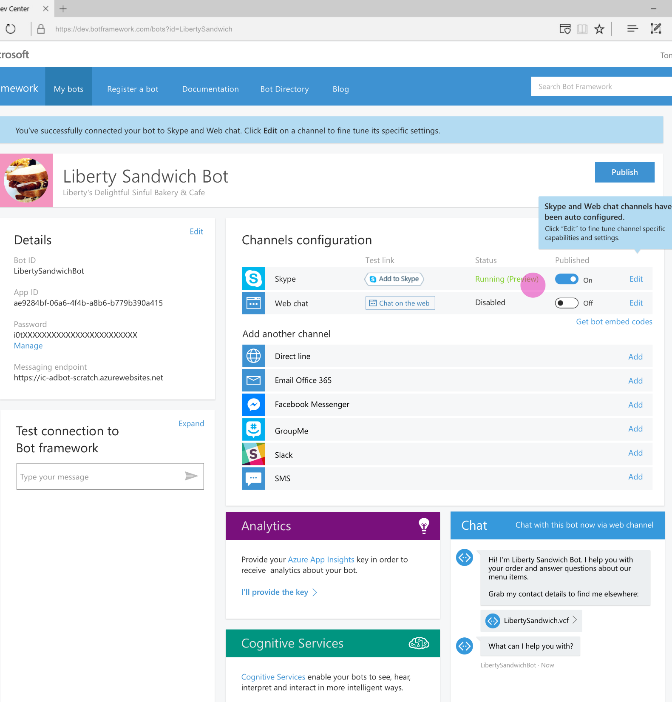
Bot Framework
Accelerate development
Framework, tools and services to build great bots that converse naturally
Reach any user
Develop once and expose through any channel including Skype, Facebook, web
Enrich the experience
Add advanced capabilities through close integration with Cognitive Services

Slide 23
Prerequisites for creating Bot
Visual Studio 2017
Bot Application template
Bot framework emulator

Slide 24
A Bare Minimum Bot Code – C#
[ResponseType(typeof(void))]
public virtual async Task<HttpResponseMessage> Post([FromBody] Activity activity)
{
if (activity != null)
{
switch (activity.GetActivityType())
{
case ActivityTypes.Message:
IConversationUpdateActivity message = activity;
using (var scope = DialogModule.BeginLifetimeScope(Conversation.Container, activity))
{
var client = scope.Resolve<IConnectorClient>();
var reply = activity.CreateReply();
reply.Text = "You said: " + message.Text;
await client.Conversations.ReplyToActivityAsync(reply);
}
}
}
}

Slide 25
Demo
Creating a new bot

Slide 26
FormFlow

Slide 27


What is FormFlow ?
How many rooms do you need?
1
How many guest?
Two
Bot
User
When is your check in date?
2018-03-14

Slide 28
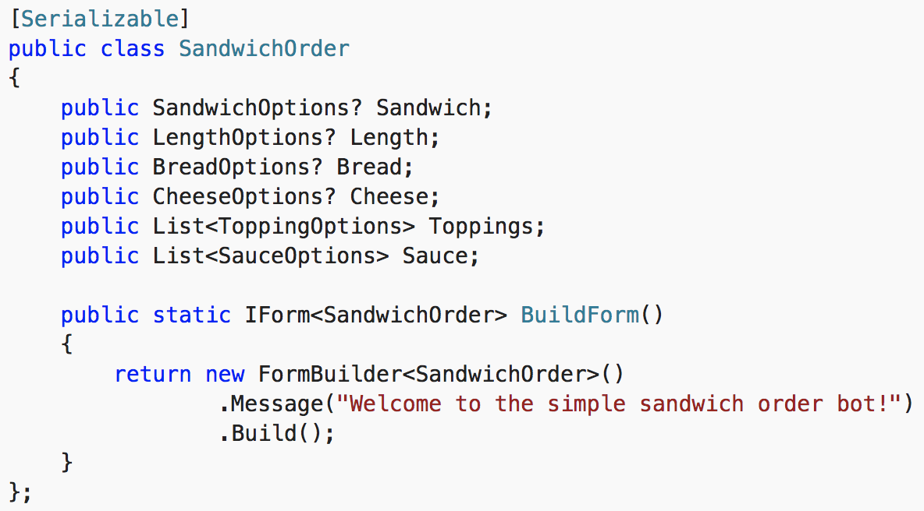
Advantages of Form Flow
Best approach for guided interactions
Define a serializable model
SDK handles collecting, binding, and flow operations (like quit)
Extended via declarative attributes or via code

Slide 29
Demo
Creating a bot with FormFlow

Slide 30
Azure Bot Service

Slide 31
Dynamics 365
Skype
Browser
Azure Bot Service
Cognitive Services
Cortana
Web
Azure ML

Slide 32



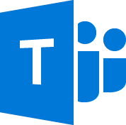

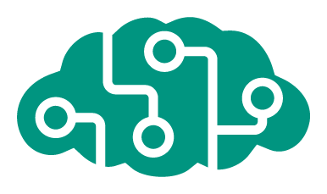







Azure Bot Service
Accelerate development
Enrich your bots
Operational efficiencies
</>
Powered by Azure Functions
Continuous deployment
Develop your way
Built in code editor
Channel support
Cognitive Services
API
Quick start templates
Integrated chat window
Direct Line support
Embedded web chat
Scale on demand
Reduced dev ops

Slide 33
Demo
Deployment of bot in Azure

Slide 34
Cognitive Services

Slide 35

Cognitive Services
Vision
Language
Speech
Search
Knowledge
Computer Vision
Face
Emotion
Content Moderator
Video
Video Indexer
Labs
Text Analytics
Spell Check
Web Language Model
Linguistic Analysis
Translator Text
Speaker Recognition
Speech
Translator Speech
Web Search
Image Search
Video Search
News Search
Entity Search
Autosuggest
Academic Knowledge
Entity Linking
Knowledge Exploration
Recommendations
QnA Maker
Custom
Custom
Custom
Custom
Custom
Vision
Language Understanding
Speech
Search
Decision

Slide 36






Why Cognitive Services?
Easy
Flexible
Tested
Roll your own with REST APIs
Simple to add: just a few lines of code required
Make the same API code call on iOS, Android, and Windows
Integrate into the language and platform of your choice
Bring your own data for your custom experience
Built by experts in their field from Microsoft Research, Bing, and Azure Machine Learning
Quality documentation, sample code, and community support
GET A KEY
BUILD

Slide 37
QnA Maker
From FAQ to Bot in minutes

Slide 38
What is QnA Maker?
Bot Platforms
Knowledge base endpoint
Indexing & Ranking
Extract QnA
QnA Maker is a free, easy-to-use, REST API and web-based service that trains AI to respond to user's questions in a more natural, conversational way.
FAQ content : txt, url, pdf, doc…

Slide 39
QnA Maker
Train a NLP Q&A model using new & existing FAQs
Actively learns: offers closest match to user & then improves
NuGet package available for Bot Framework; don’t need to use it with bots though
Need more? Look to Azure Search and integrate manually
Extract questions & answers
Diff, train, test, publish
See it in action then publish an endpoint
Integrate it with your app
REST API, add to a bot, or generate a new bot
switch (activity.GetActivityType())
{
case ActivityTypes.Message:
await Conversation.SendAsync (activity, () => new BasicQnAMakerDialog());
break;
...
}

Slide 40
Demo
Creating a new bot with QnA Maker

Slide 41
Text Analytics API

Slide 42

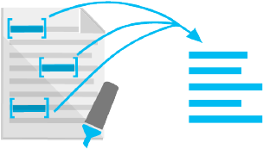
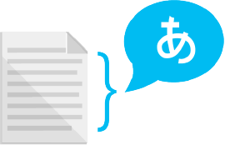
What is Text Analytics API?
Sentiment analysis
Key phrase extraction
Language detection
Easily evaluate sentiment and topics to understand what users want

Slide 43
Text Analytics
Supports basic NLP scenarios
Up to 1000 1K docs per request
Call directly from Power BI & Data Lake U-SQL; SDK supports .NET Standard + Android
Not PAYG: paid tier starts at $150 per month with 100K txns
Language detection
Over 120 languages supported
{ "name": "English", "score": 1.0 }
Sentiment analysis
From 0 (-ve) - 1 (+ve); supports 15 languages
{ "score": 0.99979335069656372 }
Key phrase extraction
Main talking points; supports 5 languages
Example
I had a wonderful experience! The rooms were wonderful and the staff was helpful.
{ "keyPhrases": [ "wonderful experience", "staff", "rooms" ] }

Slide 44
Demo
Using Text Analytics API

Slide 45
LUIS
Language Understanding Intelligent Service

Slide 46
What is LUIS?
How do I interact with my users?
What my users want?
How do I intercept my users' intents?
How do I interpret the sentiment of my users’ messages?
Skype
Browser
Azure Bot Service
Cognitive Services
Language Understanding service (LUIS)
Cortana
Web

Slide 47
LUIS
Train by providing examples
Create your own LU model
Deploy to an HTTP endpoint
Maintain model with ease

Slide 48
LUIS
{
"query": "Order me 2 pizzas",
"topScoringIntent": {
"intent": "FoodOrder",
"score": 0.9999981 }, "intents": [
{ "intent": "FoodOrder",
"score": 0.9999981 },
{ "intent": "None",
"score": 0.0604290478 }],
"entities": [
{ "entity": "pizzas",
"type": "FoodType",
"startIndex": 11,
"endIndex": 16,
"score": 0.8928091 }]
}
Book me a fligt to Cairo
Order me 2 pizzas
Where is the nearest club

Slide 49
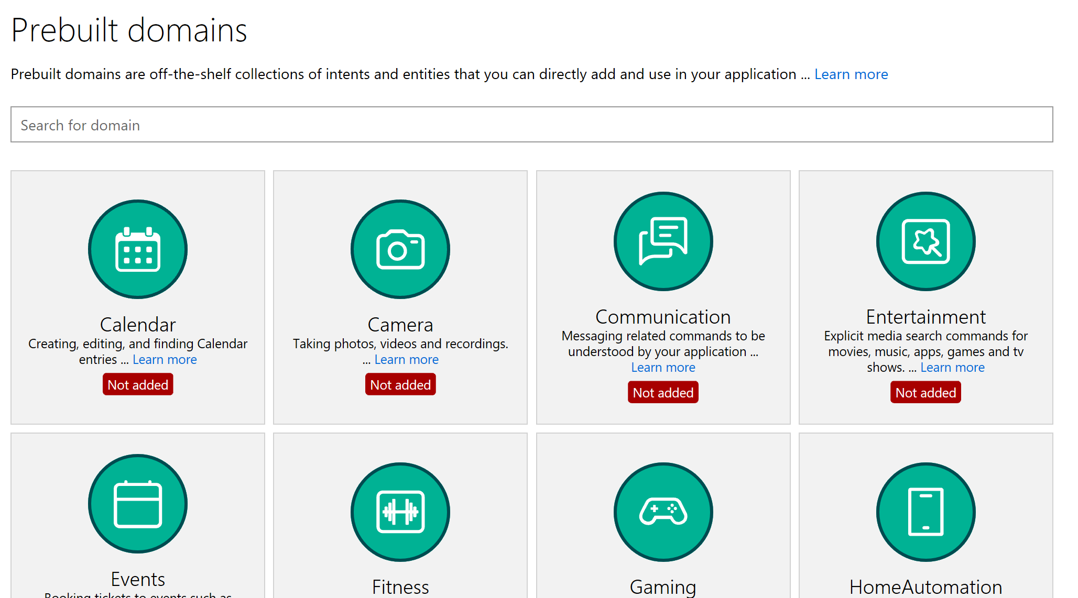
LUIS: Quick Start
Kick start your language model construction through modifiable 20 pre-built domains
Adds Intents, Entities, Utterances
Improved number, unit, money and date/times (e.g. “From May 1st to May 5th”)
Supports English, French, Dutch, Spanish, Italian, German, Korean, Portuguese, Japanese, Chinese
Age
Dimension
Email
Encyclopedia
Geography
Money
Number
Ordinal
Percentage
Phonenumber (US)
Temperature
Url

Slide 50
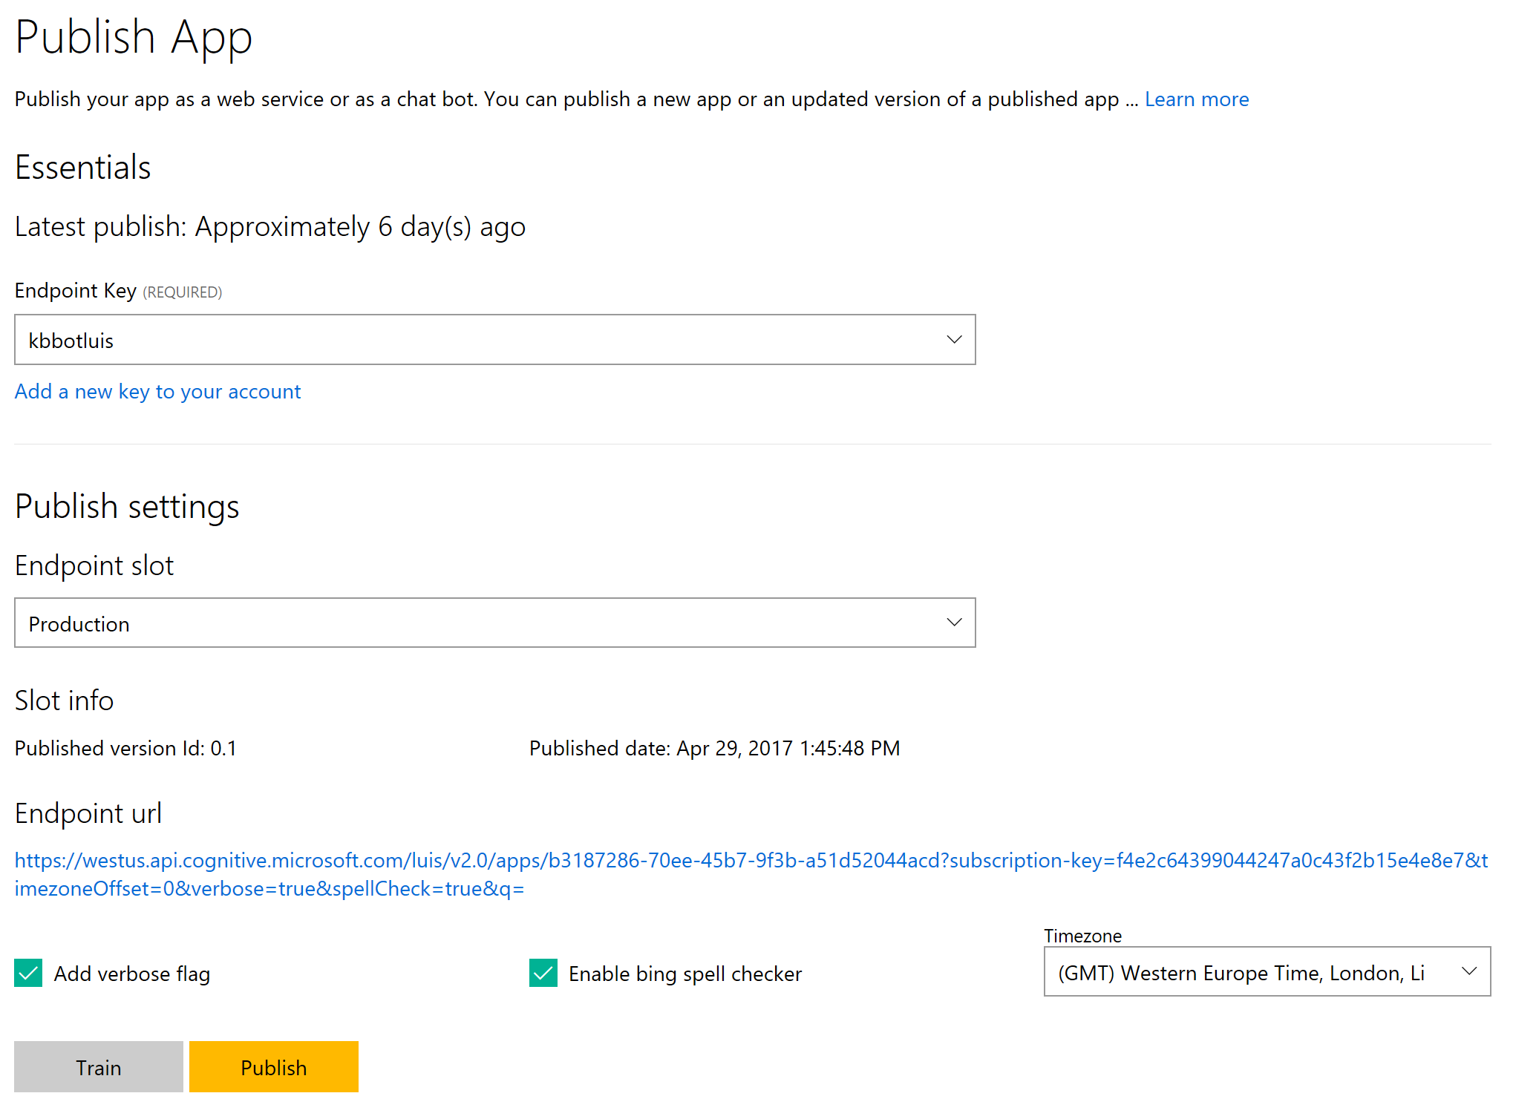
LUIS + Bing Spell Check
{ "query":
"tell me a jke", "topScoringIntent": { "intent": "Joke", "score": 0.45167464 }
{ "query":
"tell me a jke", "alteredQuery":
"tell me a joke", "topScoringIntent": { "intent": "Joke", "score": 0.99875766 }

Slide 51
Demo
Creating a new bot with LUIS

Slide 52
Developer Landscape
Cognitive Services
Customizable Cognitive Services
Azure Machine Learning
Cognitive Toolkit (CNTK)

Slide 53
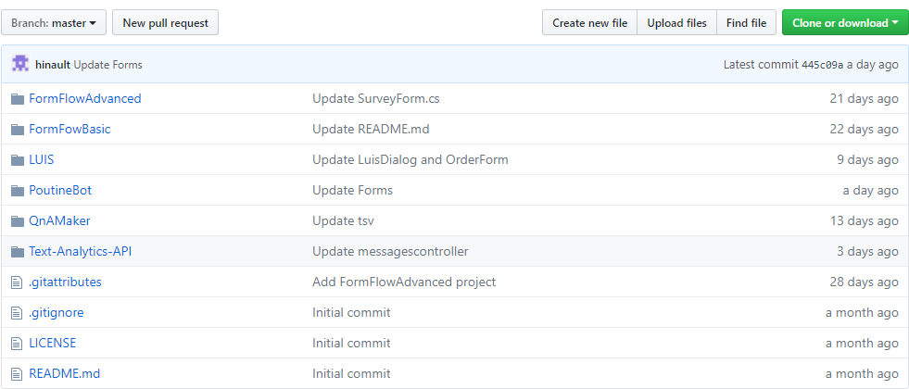
Code samples on my GitHub
https://github.com/hinault/bot-application-with-azure-cognitive-services

Slide 54
References
https://aischool.microsoft.com/
https://github.com/hinault/bot-application-with-azure-cognitive-services
https://www.luis.ai/
https://qnamaker.ai/
https://blog.botframework.com/
https://github.com/Microsoft/BotFramework-Samples

